Slide 1

Vehicle Detection Using Machine Learning
By Yash Dode

Slide 2
Project Overview
The goal is to develop a vehicle detection
Detect and identify vehicles in images
Applications:
Autonomous Driving
Traffic Surveillance

Slide 3
Techniques and Models
1. Baseline Model: Decision Tree
A simple and interpretable model.
2. Traditional Method: HOG + SVM
HOG:Extracts edge and gradient features.
SVM: Classifies the features into Vehicle/No Vehicle.
3. Deep Learning: CNN (Custom Model)
Automatically extract features.
Architecture: Conv → Pool → Dense Layers.
4. Object Detection: YOLOv5
Detects vehicles and predicts bounding boxes in one pass..

Slide 4
Process: Decision Tree
Data Preprocessing:
Convert images to grayscale.
Resize images to 64x64 pixels to ensure uniform input size.
Flatten the 2D grayscale images into 1D feature vectors for the Decision Tree classifier.
Feature Representation:
Each pixel value becomes a feature in the flattened vector.
No feature extraction methods like HOG are applied since Decision Tree directly uses raw pixel values.
Model Training:
X_train: Flattened pixel values.
y_train: Labels (Vehicle/No Vehicle).

Slide 5
Process: HOG + SVM
Data Preprocessing:
Convert images to grayscale to reduce computational complexity.
Resize images to 64x64 pixels for uniformity.
Histogram of Oriented Gradients (HOG) was used to extract features:
Edge Detection: HOG captures edge and gradient information in the image.
Orientations: Divides the image into cells and computes gradients in specific orientations.
Block Normalization: Ensures invariance to lighting changes.
HOG converts the image into a fixed-length feature vector.
Classification using SVM:
The extracted HOG features were used as input for a Support Vector Machine (SVM).
SVM finds the hyperplane that best separates the Vehicle and No Vehicle classes.

Slide 6
Process: CNN
Data Preprocessing:
Resize images to 128x128 pixels for input to the CNN.
Normalize pixel values to [0, 1] to stabilize training.
Convolutional Layers: Learn spatial features like edges, shapes, and patterns.
Pooling Layers: Reduce spatial dimensions while retaining important features.
Dense Layers: Fully connected layers combine features for classification.
Dropout: Prevent overfitting by randomly dropping neurons during training.

Slide 7
Results
Model | Accuracy | Strengths | Weaknesses
Decision Tree | 85–90% | Simple and interpretable | Poor on complex patterns
HOG+SVM | 95.75% | Strong edge-based detection | Performance dropped in images with complex backgrounds.
CNN | 99.47% | Learns robust features | Needs more data
YOLOv5 | High | Real-time detection, precise | Requires GPU for speed

Slide 8
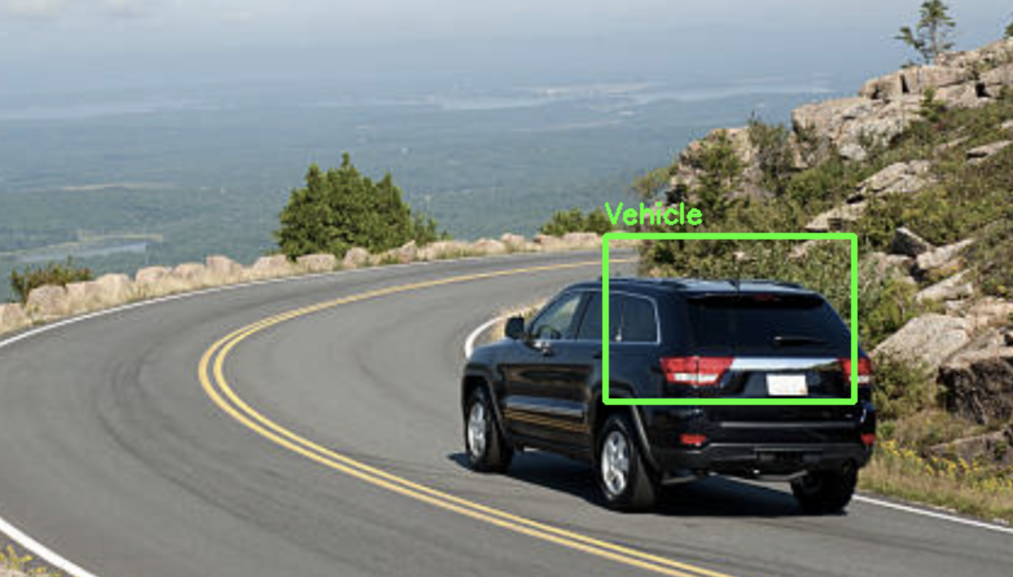
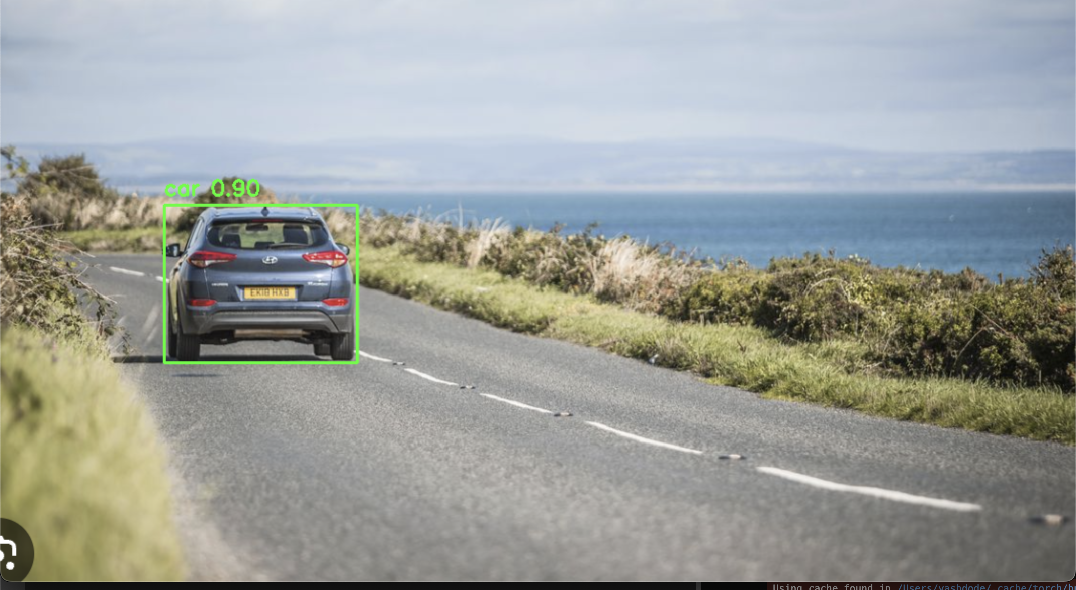
Result
Using CNN
Using YOLO

Slide 9
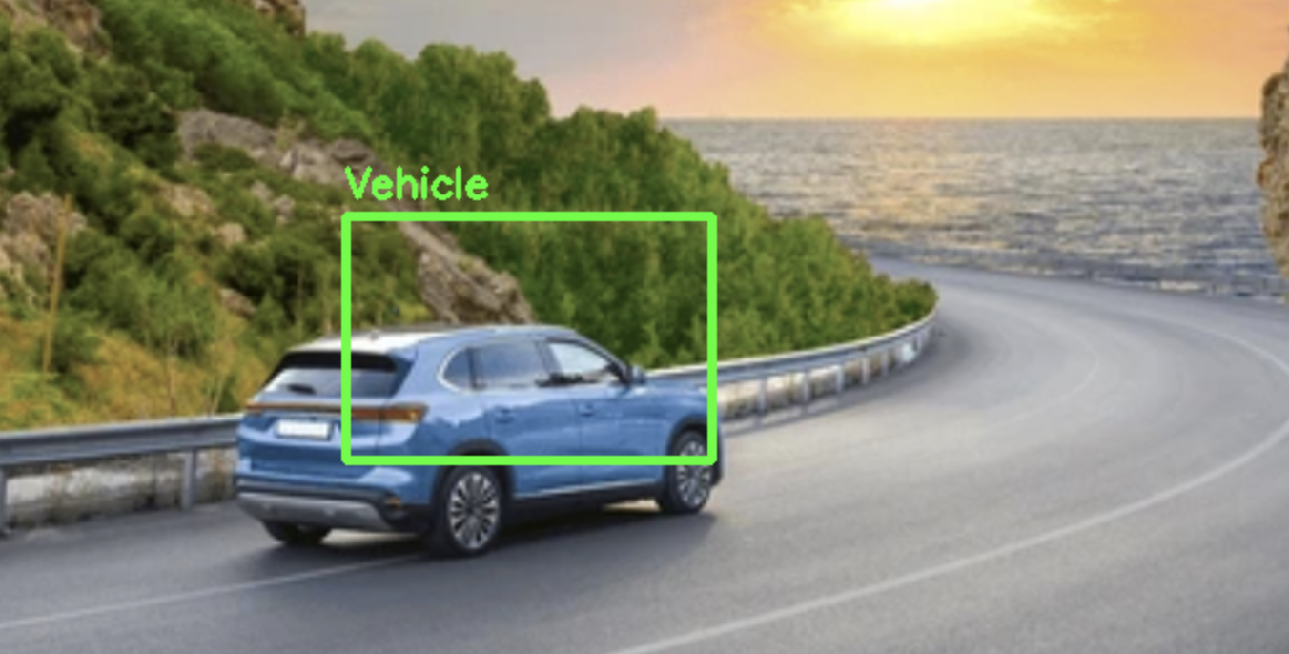
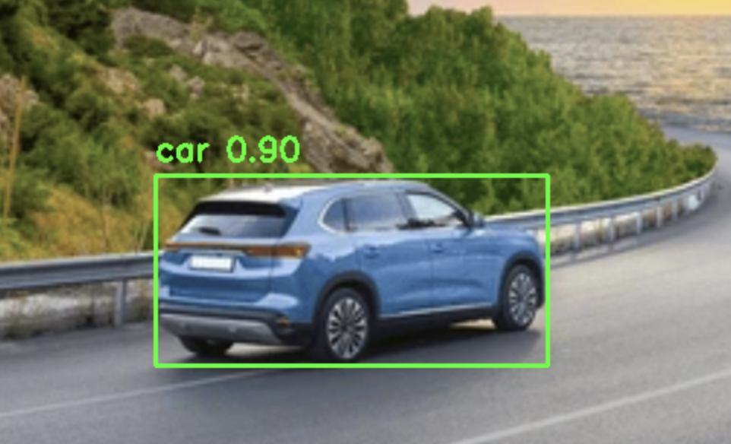
Result
CNN
YOLO

Slide 10
Conclusion
Successfully implemented and compared multiple models for vehicle detection:
Baseline: Decision Tree
Traditional: HOG + SVM
Deep Learning: CNN and YOLOv5
Achieved:
High Accuracy (99.47% with CNN).
Real-Time Detection (YOLOv5).
Future work will focus on:
Real-time video stream processing.
Custom YOLOv5 training for specific vehicle datasets.

